Slide 1
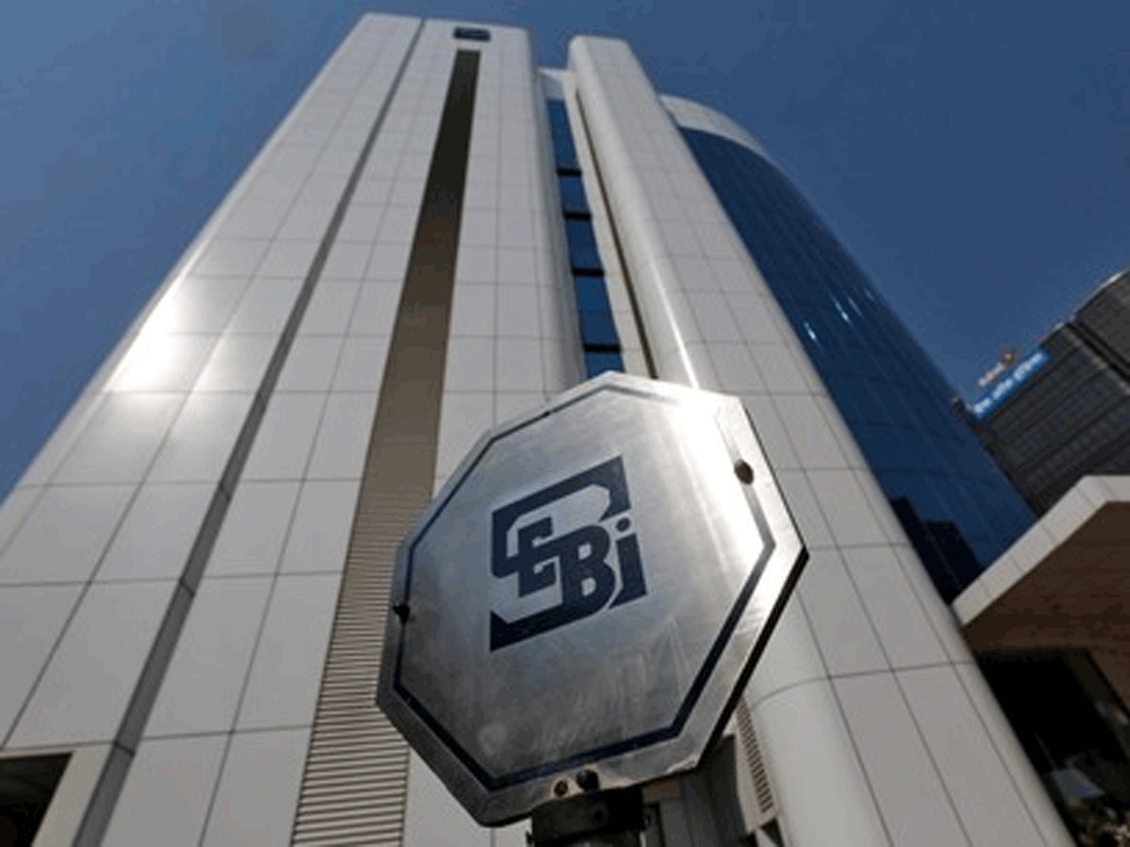
SEBI’s Guidelines for IPO
Guidelines for Making Public Offer in India

Slide 2
Table of Contents
SECTION 1
Meaning of Public Issue/Offer
Initial Public Offer (IPO)
Further Public Offer (FPO)
Benefits of Public Offer or Going Public
Introduction to SEBI
SECTION 2
SEBI Guidelines for IPO in India
SEBI Guidelines for IPO for Unlisted Companies
Profitability Route – Entry Norm 1
QIB Route – Entry Norm II
Appraisal Route – Entry Norm III
SEBI Guidelines for Public Issue for Listed Companies
SECTION 3
SEBI Guidelines for IPO in India (Contd.)
Exempted Entities under the SEBI Guidelines for IPO
Minimum Promoter’s Contribution and Lock-In
General SEBI Guidelines for IPO
Conclusion

Slide 3
Table of Contents
SECTION 1
Meaning of Public Issue/Offer
Initial Public Offer (IPO)
Further Public Offer (FPO)
Benefits of Public Offer or Going Public
Introduction to SEBI
SECTION 2
SEBI Guidelines for IPO in India
SEBI Guidelines for IPO for Unlisted Companies
Profitability Route – Entry Norm 1
QIB Route – Entry Norm II
Appraisal Route – Entry Norm III
SEBI Guidelines for Public Issue for Listed Companies
SECTION 3
SEBI Guidelines for IPO in India (Contd.)
Exempted Entities under the SEBI Guidelines for IPO
Minimum Promoter’s Contribution and Lock-In
General SEBI Guidelines for IPO
Conclusion

Slide 4
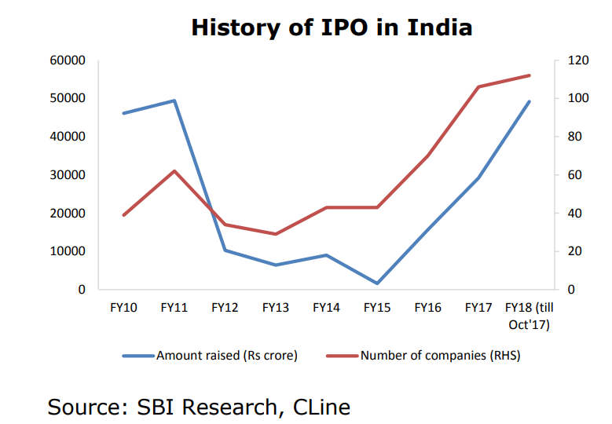
Public Issue/Offer
Public Offer or Public Issue is defined as the process of issuing securities of a company to new investors and making them a part of a company’s shareholders’ group. Public Offer is made to raise more funds and infuse more capital in the company for its financial needs and growth. Public Offer has been categorized as Initial Public Offer (IPO) and Further Public Offer (FPO).

Slide 5
Initial Public Offer & Further Public Offer
Initial Public Offer (IPO)
When a company which is not yet listed on any stock exchange, i.e. it is an unlisted company and makes a fresh issue of its securities or an offer of its existing securities for sale for the first time to the public, it is known as an Initial Public Offer or IPO. IPO allows the company to list and trade its securities on the different stock exchanges and raise a large amount of capital.
Further Public Offer (FPO)
When a company which is already listed on a stock exchange, i.e. it is a listed company, and it makes a fresh issue of securities or an offer for sale to the public, it is known as Further Public Offer (FPO), or Follow-On Offer.

Slide 6
Benefits of Public Offer or Going Public
A company may opt for making a public offer or going public for numerous reasons such as business expansion, product development, debt repayment, targeting a new market, etc. The various benefits of making a public offer for a company are summarized below:
To support and branch out the equity base of the company.
To access an easier and affordable manner of raising capital.
To boost the company’s image and goodwill in public.
To provide liquidity to the company’s directors, employees and its pre-IPO investors.
To enhance the company’s access to the equity market.

Slide 7
Introduction to SEBI
The Securities Exchange Board of India was established in 1988. It is the primary authority engaged in the regulation of Indian corporate securities market – primary market and the secondary market. Not only private entities, but also the commercial enterprises of the central government can enter the primary market to raise funds from the public to fulfil their financial requirements.
To ensure a healthy and transparent market, SEBI keeps on introducing changes to the process of Initial Public Offer – IPO. SEBI did not have any substantial powers to regulate the securities market until 1992, which was then regulated by the Controller of Capital Issues. When the Securities Exchange Board of India Act, 1992 was passed, SEBI was allotted numerous powers to regulate and supervise the securities market.

Slide 8
SEBI Guidelines for IPO in India
The SEBI – Securities Exchange Board of India (Issue of Capital and Disclosure Requirements) Regulations, 2009, otherwise known as the SEBI ICDR lays down the rules regarding the public offer in India. Additionally, the Securities Contract (Regulation) Act, 1957, the Securities Contract (Regulation) Rules, 1957 and the Companies Act, 2013 provide the legal compliances and process followed for filing an IPO.
The SEBI guidelines for IPO are divided into two processes – for unlisted companies and for listed companies.

Slide 9
Table of Contents
SECTION 1
Meaning of Public Issue/Offer
Initial Public Offer (IPO)
Further Public Offer (FPO)
Benefits of Public Offer or Going Public
Introduction to SEBI
SECTION 2
SEBI Guidelines for IPO in India
SEBI Guidelines for IPO for Unlisted Companies
Profitability Route – Entry Norm 1
QIB Route – Entry Norm II
Appraisal Route – Entry Norm III
SEBI Guidelines for Public Issue for Listed Companies
SECTION 3
SEBI Guidelines for IPO in India (Contd.)
Exempted Entities under the SEBI Guidelines for IPO
Minimum Promoter’s Contribution and Lock-In
General SEBI Guidelines for IPO
Conclusion

Slide 10
SEBI Guidelines for IPO for Unlisted Companies
There are three different routes available to an unlisted company for making its initial public offer in India
UNLISTED
COMPANY
NORM 1
NORM 2
NORM 3
Profitability Route
QIB Route
Appraisal Route

Slide 11
Profitability Route – Entry Norm 1
Under the profitability route, the following SEBI guidelines for IPO have to be followed:
The minimum net worth of the issuer must be more than INR 1 Crore in each previous three years.
The minimum net tangible assets of the issuer must be more than INR 3 Crores each, and not more than 50% of these assets must be held in the form of monetary assets in the previous three years.
The minimum average operating profit (before tax) of the company must be more than INR 15 Crores in at least three out of five previous years.

Slide 12
Profitability Route – Entry Norm 1 (Contd.)
Under the profitability route, the following SEBI guidelines for IPO have to be followed:
The issue size must not be more than five times the pre-issue net worth.
If the company has changed its name, then a minimum of 50% of the revenue in the previous year must be received from activities done under the new name.
Additionally, to provide ease of doing business and allow companies to easily make their public offer, SEBI has introduced two alternative routes for companies who are unable to fulfil the requirements under the profitability route.

Slide 13
QIB Route – Entry Norm II
Companies that require a large capital base for their operations but are unable to fulfil the conditions laid down under the profitability route can choose the QIB route to make their public offer. Under the QIB Route, company can access the public interest via the book-building procedure.
Under this process, 75% of the company’s net offer to the public must be allotted compulsorily to the Qualified Institutional Buyers (QIBs). If the company is unable to achieve the minimum subscription of QIB, it becomes liable to refund the subscription fee.
*Qualified Institutional Buyers are those institutional investors who are generally perceived to possess expertise and the financial muscle to evaluate and invest in the capital markets
*Book building is a price discovery method. In this method, the company doesn't fix up a particular price for the shares, but instead gives a price range and bidding is done

Slide 14
Appraisal Route – Entry Norm III
Under the appraisal route, the project or the public offer is appraised and participated to the extent of 15% by Financial Institutions or Scheduled Commercial Bank, of which, a minimum of 10% comes from the appraisers.
The appraisal route comes with the condition that the minimum post-issue face value capital must be INR 10 crores or a mandatory market-making must be there for at least two years.
All the above-mentioned entry norms also include the requirement of at least 1000 prospective allottees in the issuer company’s public issue.

Slide 15
SEBI Guidelines for Public Issue for Listed Companies
A listed company that wants to make a further public issue (FPO) fulfil the following SEBI guidelines:
If the company has changed its name during the last one year, at least 50% of its revenue for the previous one year must be from the activities performed by the company under its new name.
The size of its issue must not be more than five times the pre-issue net worth per the company’s audited balance sheet of its last financial year.

Slide 16
Table of Contents
SECTION 1
Meaning of Public Issue/Offer
Initial Public Offer (IPO)
Further Public Offer (FPO)
Benefits of Public Offer or Going Public
Introduction to SEBI
SECTION 2
SEBI Guidelines for IPO in India
SEBI Guidelines for IPO for Unlisted Companies
Profitability Route – Entry Norm 1
QIB Route – Entry Norm II
Appraisal Route – Entry Norm III
SEBI Guidelines for Public Issue for Listed Companies
SECTION 3
SEBI Guidelines for IPO in India (Contd.)
Exempted Entities under the SEBI Guidelines for IPO
Minimum Promoter’s Contribution and Lock-In
General SEBI Guidelines for IPO
Conclusion

Slide 17
Exempted Entities under the SEBI Guidelines for IPO
SEBI has exempted certain kinds of entities from the above-mentioned entry norms for making a public issue. These entities include:
Private and Public Sector Banks
Infrastructure company which has its project appraised by a Public Financial Institution or IDFC or IL&FS or a bank which was previously a PFI, and at least 5% of its project cost is funded by any of these institutions. No entry norms are provided for a listed company that wants to make a rights issue.

Slide 18
Minimum Promoter’s Contribution and Lock-In
When an unlisted company makes a public issue, the promoters of the company must contribute at least 20% of the post-issue capital. This capital must be locked in for at least three years. This period is also called the lock-in period, which represents the freezing of such shares for that period. The remaining pre-issue capital of the company must also be locked in for a period of one year from the date of listing.
When a listed company makes a public issue in the form of Further Public Offer or FPO, the promoters of the company must contribute at least 20% of the post-issue capital or 20% of the total issue size. This requirement is in place to make sure that the promoters retain some part of the company’s stakes once the company makes its public offer.

Slide 19
General SEBI Guidelines for IPO A company that wants to make a public offer must also adhere to the following general SEBI guidelines for IPO in India:
The directors, promoters or other KMPs must not be associated with any other company in a similar role.
The directors, promoters or any other key management personnel who have the control of the company must not be debarred from accessing the primary market.
The application to list the company’s shares must be filed with a recognized stock exchange in India.
The company must enter into legal contracts with a depository to dematerialize its specific securities.

Slide 20
General SEBI Guidelines for IPO (2)
The partly paid-up equity shares must be fully paid-up.
A listed company must maintain a minimum public shareholding of 25%. In case of failure to do so, the company gets one year to meet the requirement.
A company must make financial arrangements from trust and verifiable sources for its financial requirements, excluding the amount put up to issue new company shares.
The process of an initial public offer of more than INR 50 lakhs must start with the company filing a draft offer in the form of Draft Red Herring Prospectus with the SEBI.

Slide 21
General SEBI Guidelines for IPO (3)
Once the draft is reviewed and received by the company along with the issue of final observation letter, the final offer document or the red herring prospectus must be filed with the Registrar of Companies (ROC).
The company may choose the book building process under Entry Norm II. In this case, the company must complete the IPO process within one year from the date of receiving the final observation letter from SEBI.
50% of the Board of Directors of the company must be independent investors.
The same 50% of the Board of Directors of the company must have no obligations to the promoters or the company.

Slide 22
General SEBI Guidelines for IPO (4)
No directors or promoters of the company must be guilty of an economic offence.
The company or any of its promoters or directors must not be a wilful defaulter.
The issuer company must disclose the number of shares or the number of shares to SEBI between the date of filing its draft red herring prospectus and issue of specified securities.
If a company wants to go for a public issue of more than INR 100 crore, it must submit a draft offer document with the regional office of SEBI before doing so.
into legal contracts with a depository to dematerialize its specific securities.

Slide 23
Conclusion
The SEBI Guidelines for IPO by a company in India are directed towards one goal – protection of the interest of the company as well as its shareholders. Sometimes, a company may resort to unauthorized or unlawful ways to infuse more capital, and this may hamper the interest of the shareholders. Through the SEBI guidelines for IPO, it is able to ensure a lawful process of an initial public offer by a company and there exits a level playing field for everyone.
Nonetheless, the shareholders must perform detailed due diligence before going for a company’s initial public offer, and at the same time, a company must follow all the regulations and SEBI guidelines for IPO before it makes its first public offer or ‘go public’.

Slide 24
Sources
http://iepf.gov.in/IEPF/Regulations_IPO.html
https://enterslice.com/learning/sebi-guidelines-for-making-public-offer/
https://savart.in/blog/requirements-to-file-an-ipo-in-india/
http://www.iepf.gov.in/IEPF/Eligibility_norms.html
https://en.wikipedia.org/wiki/Initial_public_offering
SBI Research, Cline
https://www.moneycontrol.com/glossary/ipo/who-is-qualified-institutional-buyer-qibs_797.html
https://www.sebi.gov.in/sebi_data/commondocs/subsection1_p.pdf
https://www1.nseindia.com/products/content/equities/ipos/about_ipos.htm
http://iepf.gov.in/IEPF/Types_of_Issues.html
https://www.bseindia.com/Static/PublicIssues/aboutIPO.aspx

Slide 25
Appendix

Slide 26
SEBI Guidelines for Selling Shareholders
Selling shareholders are the current investors of the company who offer a certain amount of securities for sale during the initial public offer. Under the SEBI ICDR Regulations, 2018, the selling shareholders must provide the following information at the time of IPO:
A statement must be provided on the front page of the offer document, laying down their responsibilities up to the extent of shares they want to offer at the time of the IPO.
The pre-issue shareholding of the shareholder in the form of a percentage of the total paid-up capital.
The weighted average price of securities at which they were acquired during the previous one year.

Slide 27
Qualified Institutional Buyers (QIBs)
Qualified Institutional Buyers (QIBs) those institutional investors who are generally perceived to possess expertise and the financial muscle to evaluate and invest in the capital markets. ‘Qualified Institutional Buyer’ shall mean:
Public financial institution as defined in section 4A of the Companies Act, 1956
Scheduled commercial banks
Mutual Funds
Foreign institutional investor registered with SEBI
Multilateral and bilateral development financial institutions
Venture Capital funds registered with SEBI
Foreign Venture Capital investors registered with SEBI
State Industrial Development Corporations
Insurance Companies registered with the Insurance Regulatory and Development Authority (IRDA).
Provident Funds with minimum corpus of Rs.25 crores
Pension Funds with minimum corpus of Rs. 25 crores "These entities are not required to be registered with SEBI as QIBs. Any entities falling under the categories specified above are considered as QIBs for the purpose of participating in primary issuance process

Slide 28
Types of Issues in Indian market
Types of Issues
Public Issue
Rights Issue
Bonus Issue
Composite Issue
Private Placement
IPO
FPO
Preferential Issue
Qualified Institutional Placement
Institutional Placement Programme
Primarily, issues made by an Indian company can be classified as Public, Rights, Bonus and Private Placement. While right issues by a listed company and public issues involve a detailed procedure, bonus issues and private placements are relatively simpler.
*For further details refer to - https://www.sebi.gov.in/sebi_data/commondocs/subsection1_p.pdf

Slide 29
Pricing of Issue
On the basis of Pricing, an issue can be further classified into Fixed Price issue or Book Built issue.
Fixed Price Issue: When the issuer at the outset decides the issue price and mentions it in the Offer Document, it is commonly known as “Fixed price issue”.
Book built Issue: When the price of an issue is discovered on the basis of demand received from the prospective investors at various price levels, it is called “Book Built issue”.
Issue Type | Offer Price | Demand | Reservations
Fixed Price Issues | Price at which the securities are offered and would be allotted is made known in advance to the investors | Demand for the securities offered is known only after the closure of the issue | 50 % of the shares offered are reserved for applications below Rs. 2 lakh and the balance for higher amount applications.
Book Building Issues | A 20 % price band is offered by the issuer within which investors are allowed to bid and the final price is determined by the issuer only after closure of the bidding. | Demand for the securities offered , and at various prices, is available on a real time basis on the BSE website during the bidding period.. | 50 % of shares offered are reserved for QIBS, 35 % for Non Retail and 15% for Retail Investors

Slide 30
Book Building Issue
When the price of an issue is discovered on the basis of demand received from the prospective investors at various price levels, it is called “Book Built issue”.
Price Band
The offer document may have a floor price for the securities or a price band within which the investors can bid. The spread between the floor and the cap of the price band can not be more than 20%. In other words, it means that the cap should not be more than 120% of the floor price.
Floor Price
Floor price is the minimum price at which bids can be made.
Cut-off Price
In Book building issue, the issuer is required to indicate either the price band or a floor price in the red herring prospectus. The actual discovered issue price can be any price in the price band or any price above the floor price. This issue price is called “Cut off price”.

Slide 31
Private Placement
When an issuer makes an issue of shares or convertible securities to a select group of persons not exceeding 49, it is called a private placement. Private placement of shares or convertible securities by listed issuer can be of three types:
Preferential allotment: When a listed issuer issues shares or convertible securities, to a select group of persons in terms of provisions SEBI (ICDR) Regulations, 2009, it is called a preferential allotment. The issuer is required to comply with various provisions which inter‐alia include pricing, disclosures in the notice, lock‐in etc., in addition to the requirements specified in the Companies Act.
Qualified institutions placement (QIP): When a listed issuer issues equity shares or non-convertible debt instruments to Qualified Institutions Buyers only, in terms of SEBI (ICDR) Regulations, 2009, it is called a QIP.
Institutional Placement Programme (IPP): When a listed issuer makes a further public offer of equity shares, or offer for sale of shares by promoter/promoter group of listed issuer in which the offer, allocation and allotment of such shares is made only to qualified institutional buyers in terms of SEBI (ICDR) Regulations, 2009 for the purpose of achieving minimum public shareholding, it is called an IPP.

Slide 32
KEY FINANCIAL TERMS
Paid-Up Capital
Paid-up capital is the amount of money a company has received from shareholders in exchange for shares of stock. Paid-up capital is created when a company sells its shares on the primary market directly to investors, usually through an initial public offering (IPO). When shares are bought and sold among investors on the secondary market, no additional paid-up capital is created as proceeds in those transactions go to the selling shareholders, not the issuing company
Authorized Capital
The authorized capital of a company (sometimes referred to as the authorized share capital, registered capital or nominal capital, particularly in the United States) is the maximum amount of share capital that the company is authorized by its constitutional documents to issue (allocate) to shareholders.
Share Capital
A corporation's share capital or capital stock is the portion of a corporation's equity that has been obtained by the issue of shares in the corporation to a shareholder, usually for cash. "Share capital" may also denote the number and types of shares that compose a corporation's share structure.

Slide 33
KEY FINANCIAL TERMS - 2
Oversubscribed IPO
It is said an IPO oversubscribed when the number of shares that investors want to buy is higher than the number of shares available in the stock exchanges (authorized capital)
In case of oversubscription, According to SEBI guidelines, if an IPO is oversubscribed in the retail category, the shares are to be allotted in a manner that ensures that every retail bidder gets at least one minimum lot. The remaining shares, if any, are then allotted on pro rata basis.
Undersubscribed IPO
When the total number of shares that the investors are willing to buy is less than total number of shares available in stock exchanges during the process of IPO, the IPO is said to be undersubscribed.
Green shoe option
A green shoe is a clause contained in the underwriting agreement of an initial public offering (IPO) that allows underwriters to buy up to an additional 15% of company shares at the offering price. This allows the total authorized capital to be increased by 15% at max.

